Slide 1
Connect to the database
Grab the data and go

Slide 2
In this video…
How connections connect
How drivers translate from JDBC speak to MySQL speak
Video project:
Create recipe schema and a user
Implement a "main" class
Implement a class to obtain a connection

Slide 3
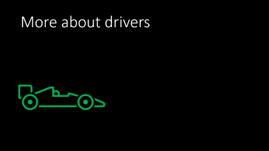
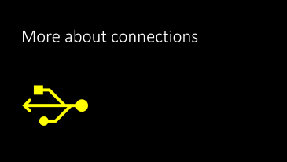
What's coming…

Slide 4

More about connections

Slide 5
Transmission Control Protocol (TCP)
A connection to MySQL is done with TCP
TCP…
Connects two computers together (like a circuit or phone call)
Is reliable – the data is guaranteed to be received in the right order
Is bidirectional – data is sent and received by either side
Can have multiple connections open simultaneously

Slide 6
More TCP
The connection remains open until it is explicitly closed
When the connection is established, data is exchanged so that both sides agree on the data format, compression, encryption, etc.
Establishing a connection is slow – using a connection is fast
Connections can be reused and pooled (but not if they're closed)
TCP is managed by computer hardware

Slide 7
Database language
Each database has its own different "language" (protocol) that it uses to communicate with clients
The Java Database Connectivity (JDBC) classes do not know the language that MySQL uses!

Slide 8

More about drivers

Slide 9
The database driver
The database driver works with the computer hardware to establish a reliable connection with the database server
The MySQL driver "translates" between JDBC calls and the MySQL language

Slide 10

Programmer writes in JDBC format:
String sql = "SELECT * FROM table";
String url = "jdbc:mysql://host:port/schema";
Connection conn = DriverManager.getConnection(url);
PreparedStatement ps = conn.prepareStatement(sql);
ResultSet rs = ps.executeQuery();
Finds and
loads driver
Driver translates and sends to MySQL server
Sends request
to MySQL
MySQL server receives:
[03] COM_QUERY
SELECT * FROM table

Slide 11
Driver selection
JDBC finds all database drivers on the classpath
It selects the correct driver based on the connection string (url) passed to the DriverManager class
MySQL connection string format:
jdbc:mysql://host:port/schema

Slide 12
Watch the project grow!
MySQL Workbench: Create schema and user
Java: Create the connection class to manage the connection

